Slide 1

Zomato Restaurants data
R PROGRAMMING
R Programming for Analytics

Slide 2



Group member
Trần Văn Thắng
R Programming
Trần Minh Đức
Lê Minh Hoàng
20133121
20133037
20161317

Slide 3
Zomato restaurants data
R Programming
Objectives of the study:
Restaurant dataset analysis obtained from the website “Zomato”
Zomato is India's largest food ordering platform
This analysis caters to those who want to learn about prices between restaurants
Help the community find quality food and restaurants

Slide 4
21 Variables in the dataset:
R Programming
Restaurant Id, Restaurant Name, Country Code, City, Address, Locality, Locality Verbose, Longitude, Latitude, Cuisines, Average Cost for two, Currency, Has Table booking, Has Online delivery, Is delivering, Switch to order menu, Price range, Aggregate Rating, Rating color, Rating text, Votes
Data collection:
Data has been collected from the Zomato API in the form of .json files(raw data)

Slide 5
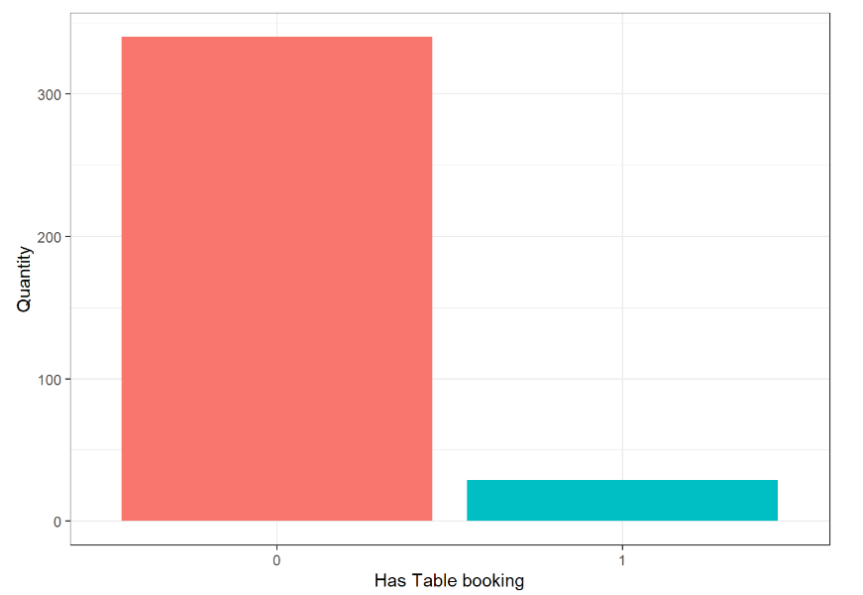
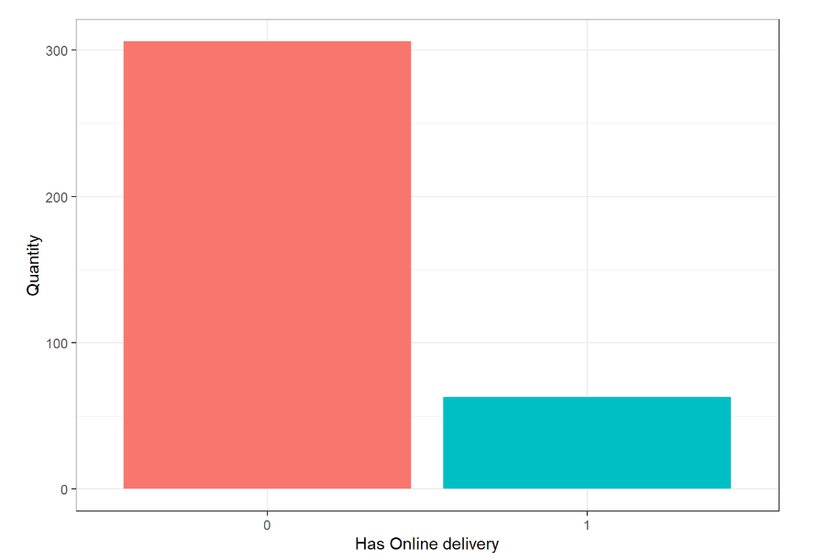
EDA
R Programming
TOTAL NUMBER OF RESTAURANTS FOR 2 SERVICES
0
No
1
Yes

Slide 6
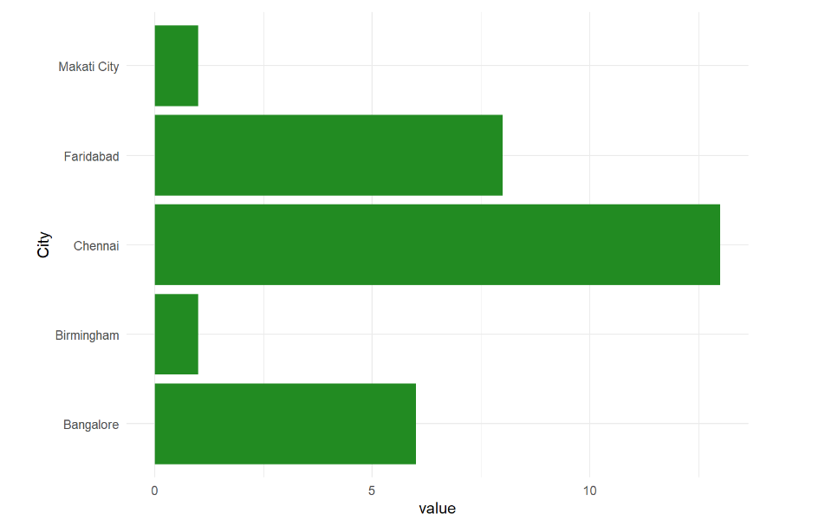
EDA
R Programming
Restaurants with Has Table Booking service are mainly in cities

Slide 7
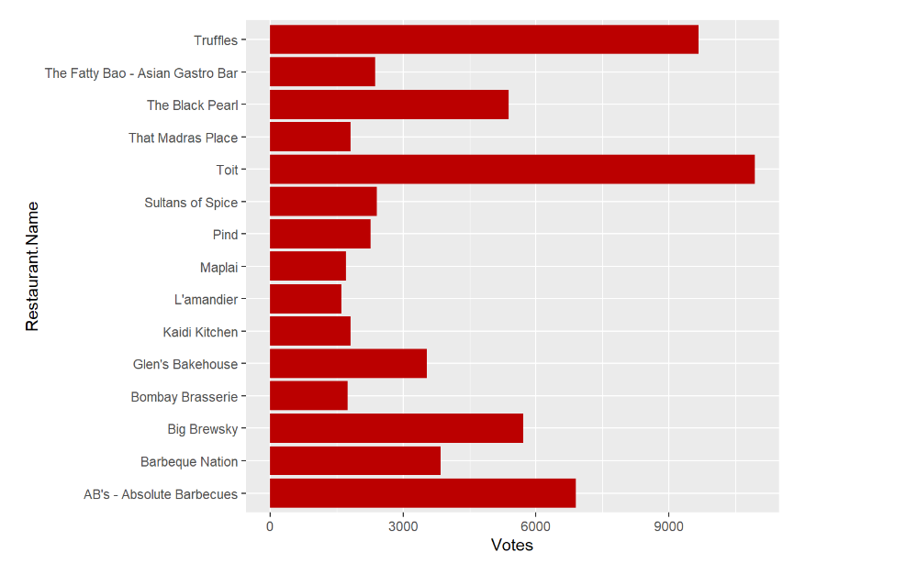
EDA
R Programming
15 restaurants with the highest Votes

Slide 8
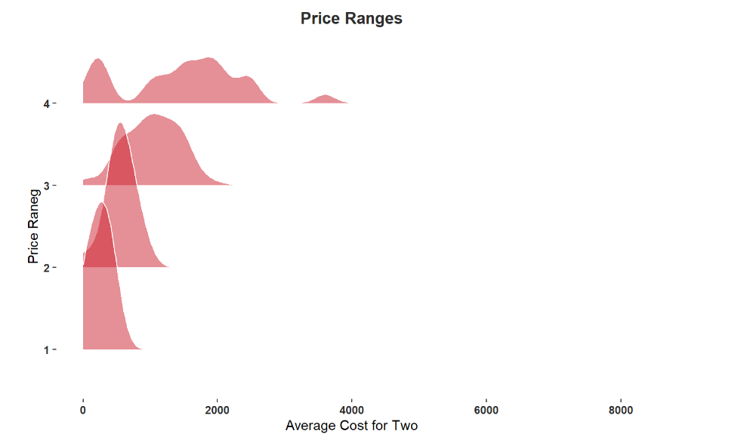
EDA
R Programming
Average cost for 2 people for popular food Price Range

Slide 9
Hypothesis testing
Q.1
Q.2
Q.3
Q.4
R Programming
Does the data provide evidence that restaurants that do not allow reservations have significantly more Votes than restaurants that do?
Does the data provide evidence that restaurants without online delivery have significantly more Votes than restaurants with online delivery?
Does the data provide evidence that the average amount 2 people eat at a restaurant determines the number of Votes in each restaurant?
Does the data provide evidence of a significant “level effect” on Votes?

Slide 10
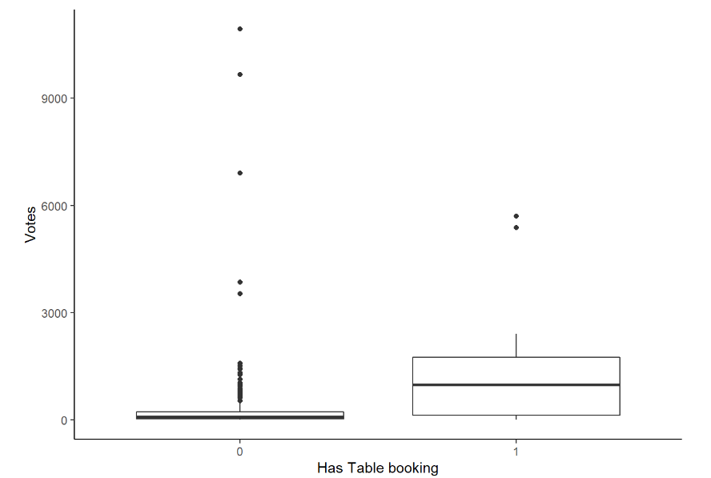
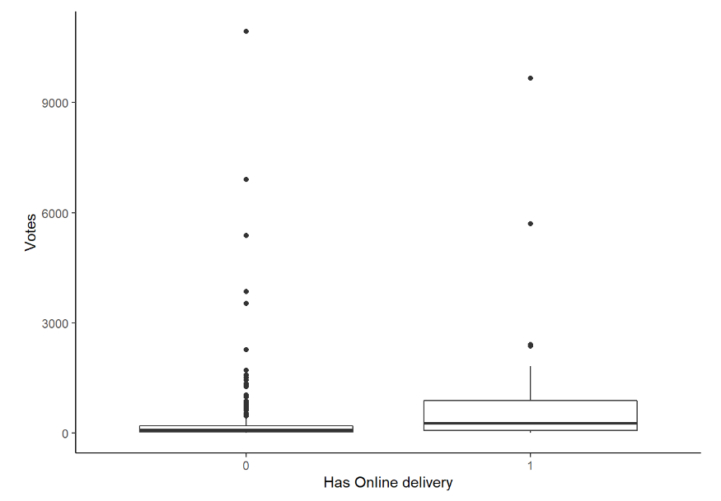


R Programming
Q.1
Q.2
P-value < α = 0,05
P-value < α = 0,05
reject hypothesis H0
reject hypothesis H0

Slide 11
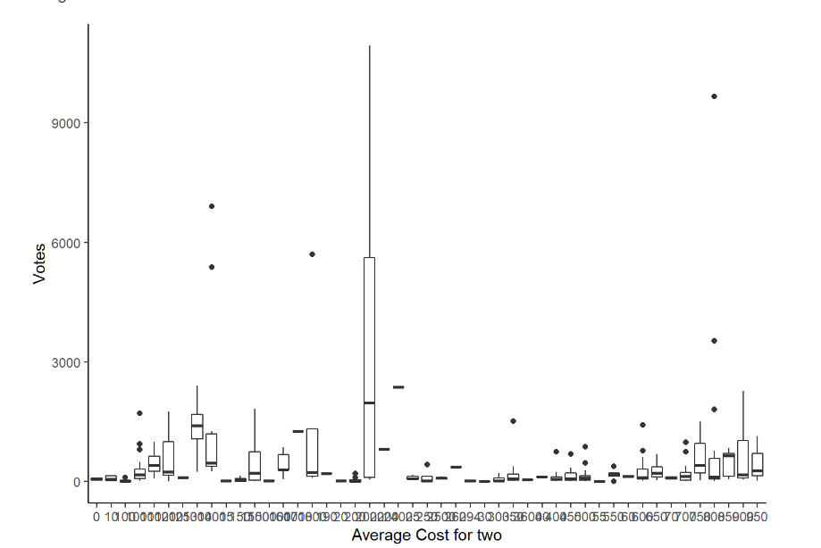

R Programming
Q.3
P-value > α = 0,05
accept hypothesis H0

Slide 12
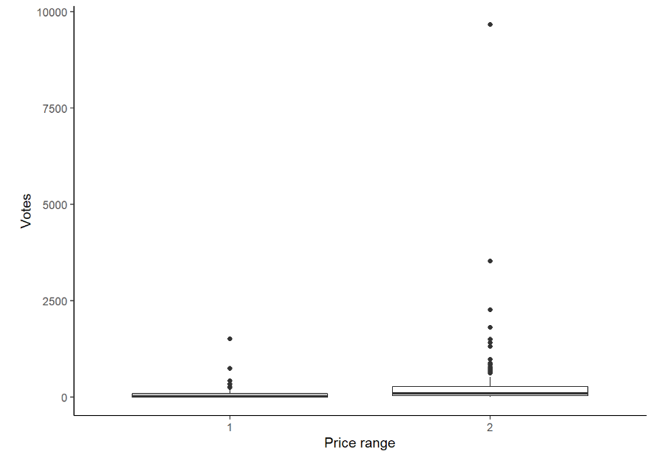
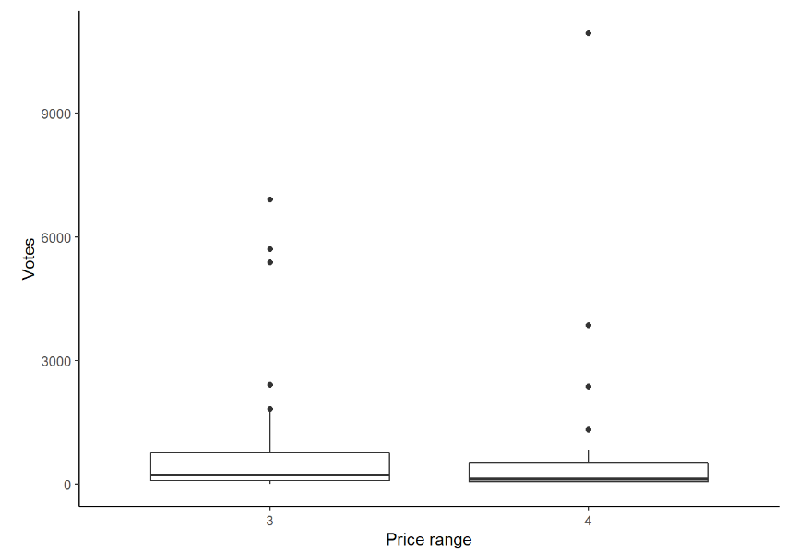
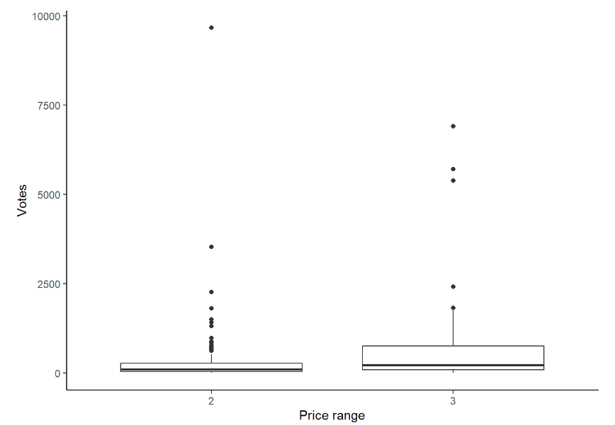

R Programming
Q.4
Price range 1,2
Price range 3,4
Price range 2,3
P-value < α = 0,05
P-value > α = 0,05
P-value < α = 0,05
reject hypothesis H0
accept hypothesis H0
reject hypothesis H0

Slide 13

Conclusion
R Programming
Statistical testing almost always gives a very small p-value, which indicates that the evidence provided by the data is strong enough to reject the H0 hypothesis.
This is an observational study, no causal conclusions can be drawn.
The only case where the word association implies causation is when the study is a randomized experiment.

Slide 14
THANKS For Listening!
R programming

